Slide 1



Presentation on
“Travel App”
Capstone Project
Presented by:
Name: SAGAR KUMAR GUPT Batch Wipro Salesforce B13 (WIP-SF-13)
LMS Id: MGSA_490 Date: 28/02/2023

Slide 2
Contents :
Objective
Introduction
Module 1
Module 2
Module 3
Travel App Playground
Code App Playground

Slide 3
Objective :
Building a Lightning app, adding tabs, and customizing page layouts.
Creating custom objects and fields for the app.
Defining relationships between objects.
Importing data and testing the app.

Slide 4
Introduction :
This project is about a Travel Approval App.
We need to build an app for an organisation by which employees can place
the travel approval requests under their manager.
In which the manager has the privilege to approve or reject the request and the administrator can see the report of total requests by “Month” or by “Department” using a Dashboard.

Slide 5
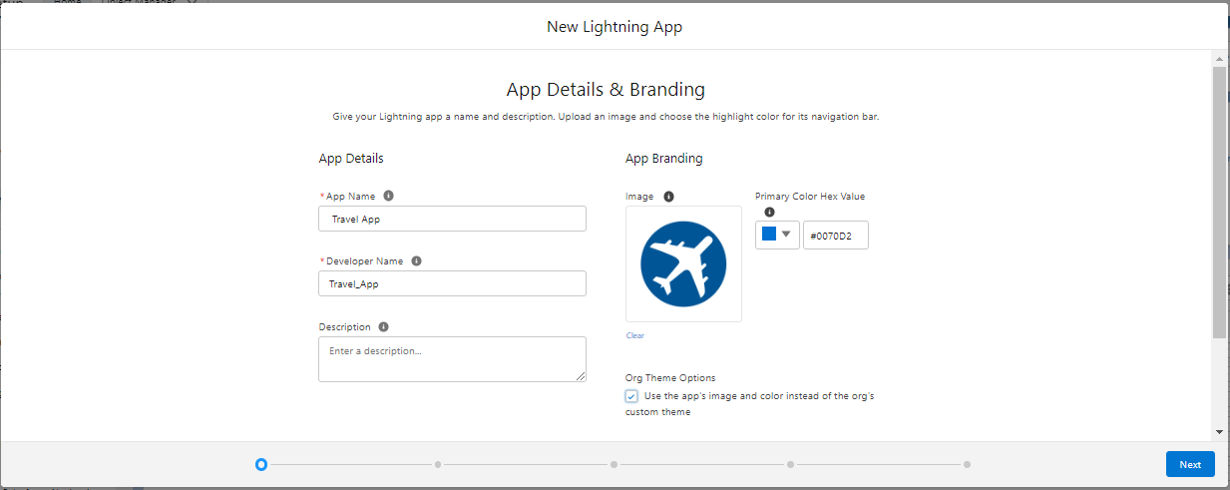
Module 1:
Travel App Playground
Create a new custom lightning App, name: Travel App.

Slide 6
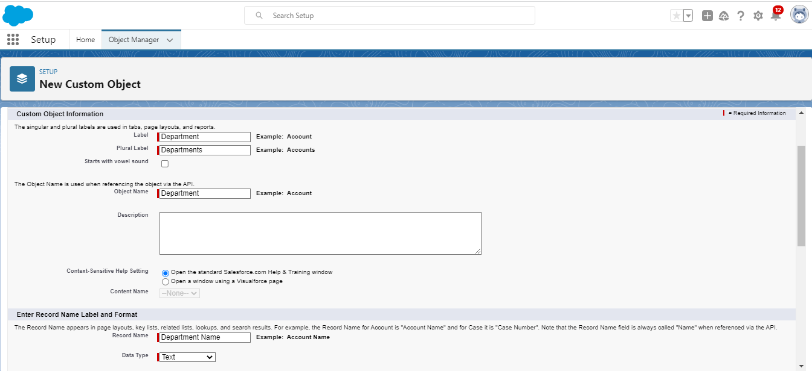
Creating Custom Objects Department, Travel Approval & Expense Items

Slide 7
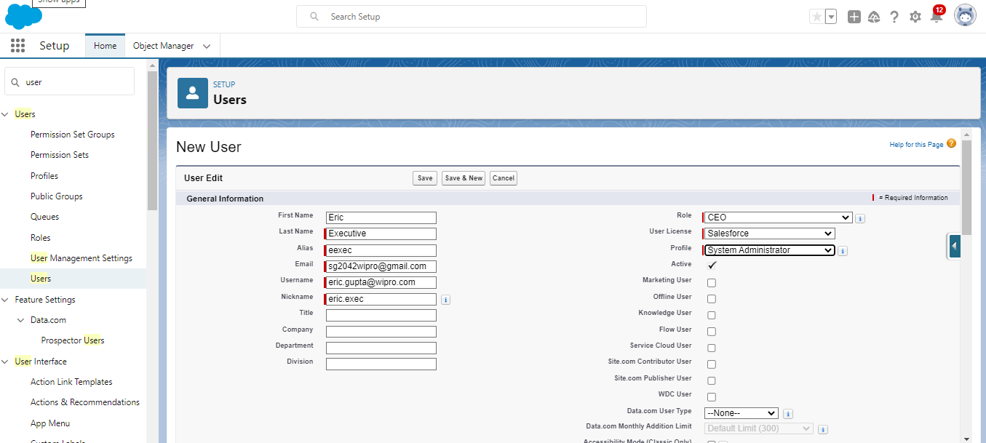
Create a user .

Slide 8
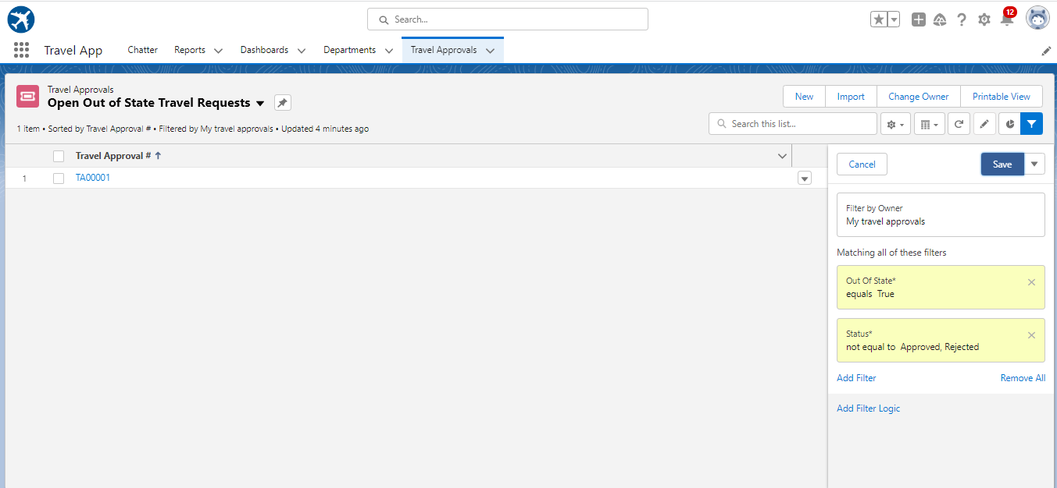
Create Travel approval custom List View

Slide 9
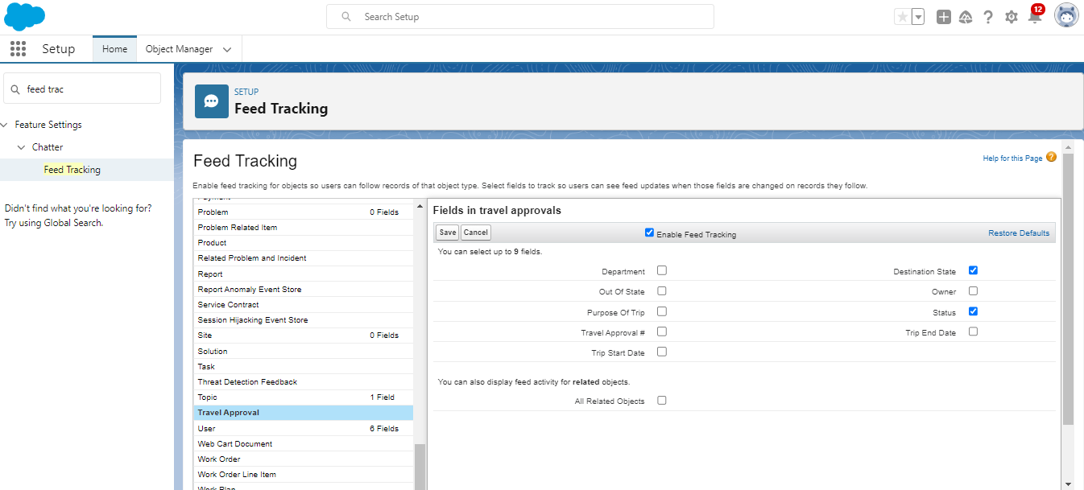
Enable Chatter on the Travel Approval Object.

Slide 10
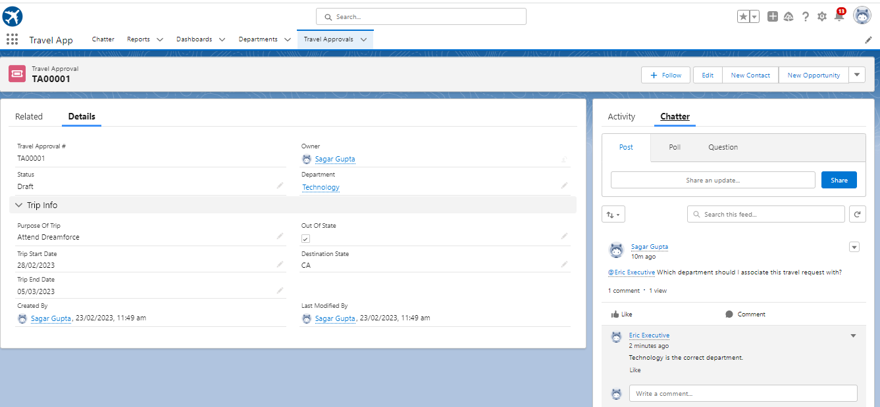
Test the App :
After completing the Module 1 you will see the user can post their query by using chatter and other can reply to that query.
Now, Here Our module 1 is completed.
Lets move to our next
Module 2….

Slide 11
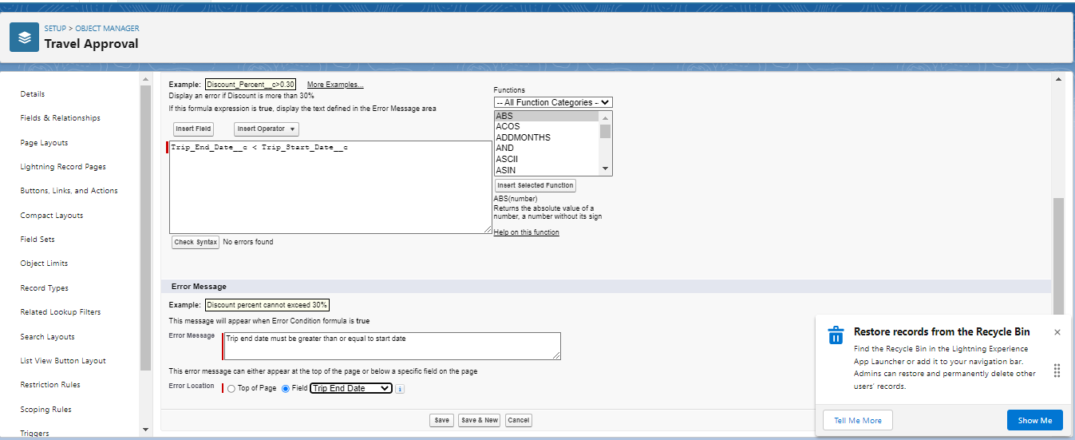
Module 2:
Create Validation Rule

Slide 12
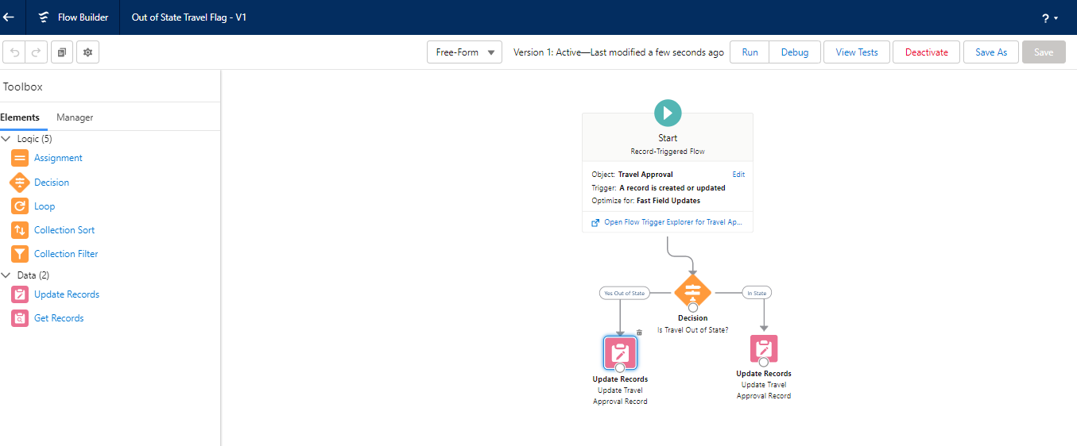
Create a Record – Triggered Flow.

Slide 13
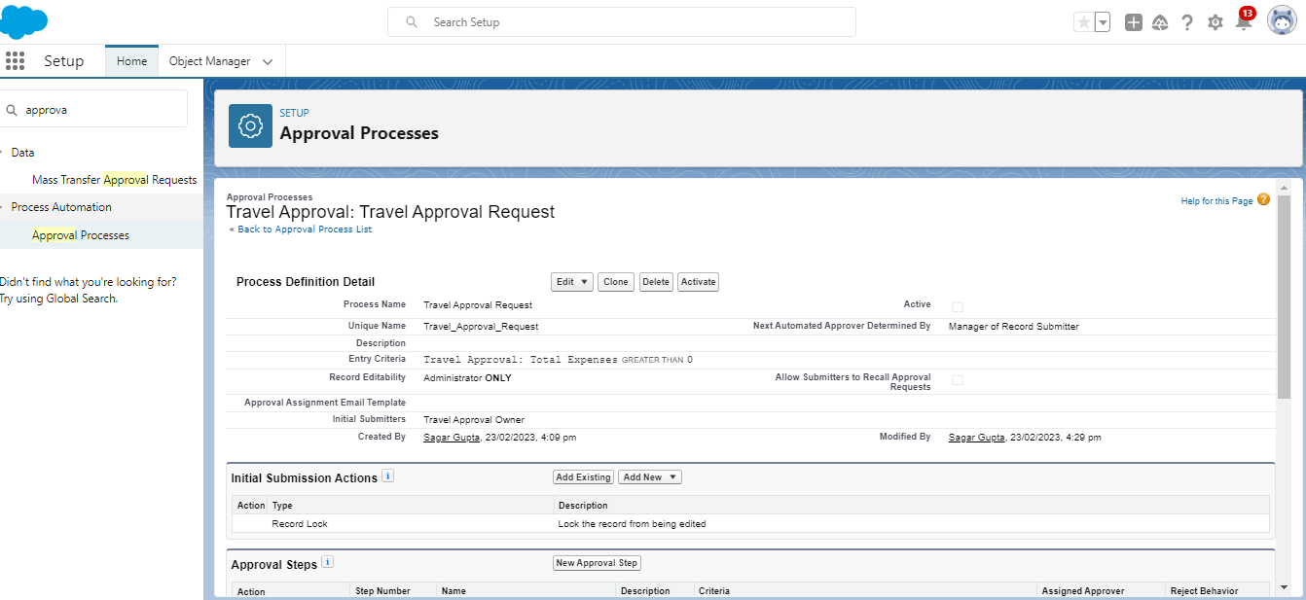
Create an Approval Process to send Travel approvals to Manager or Travel coordinator.

Slide 14
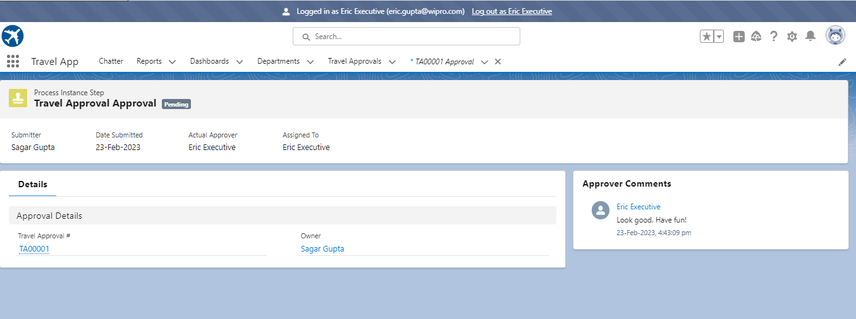
Test The Approval Process

Slide 15
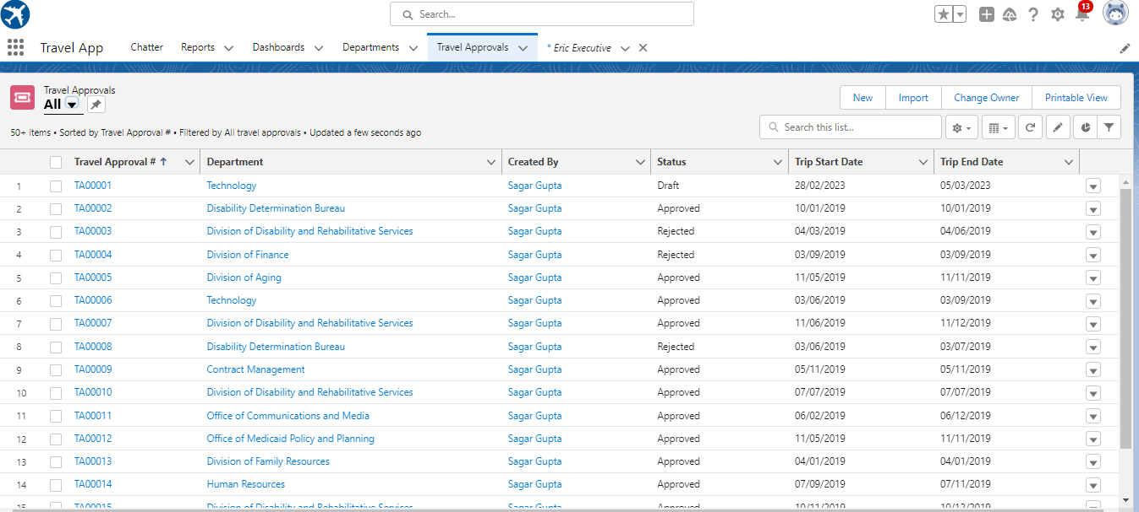
Use Data Import Wizard to import Travel Approval records.

Slide 16
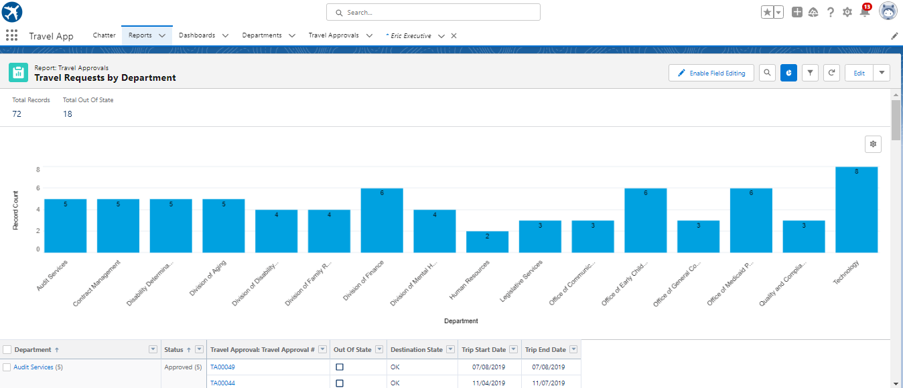
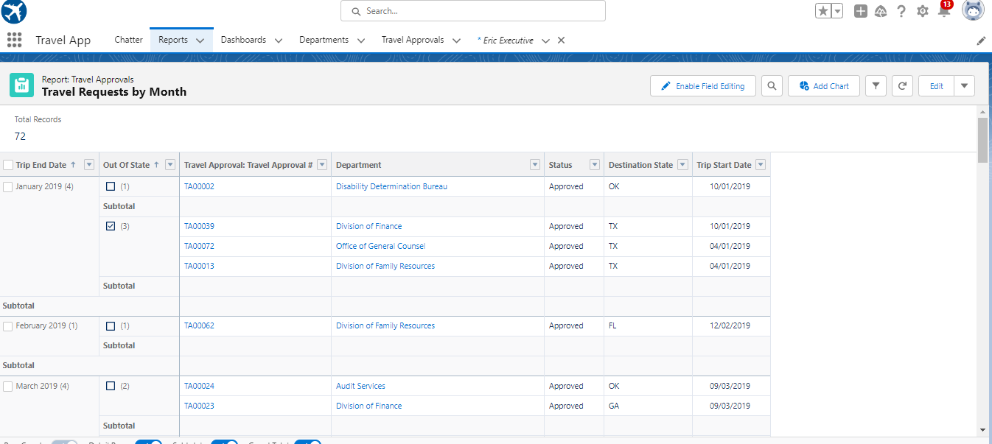
Create a Travel Requests by-
Department Report
Month Report

Slide 17
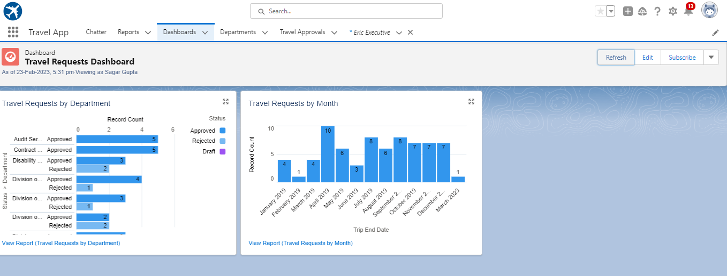
Create a Travel Approvals Dashboard

Slide 18
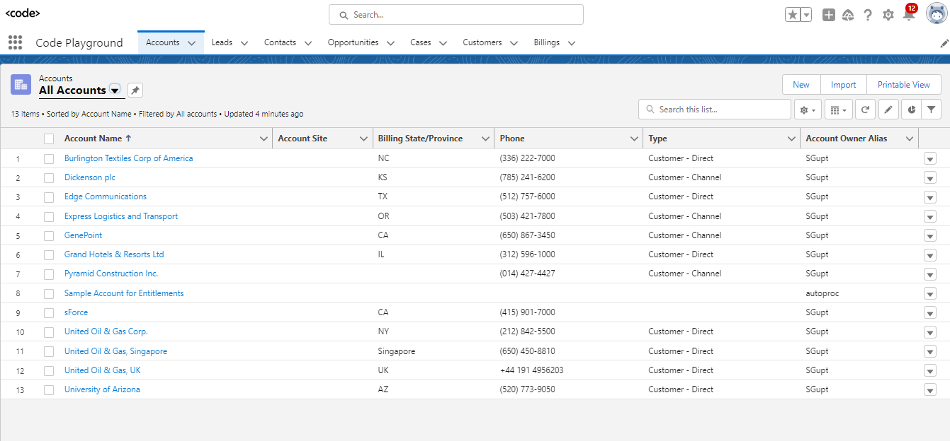
Create a new custom lightning App, name: Code Playground.
Code App Playground
Module 3 :

Slide 19
Rest of the module
Lets , see through Project Report.

